Slide 1
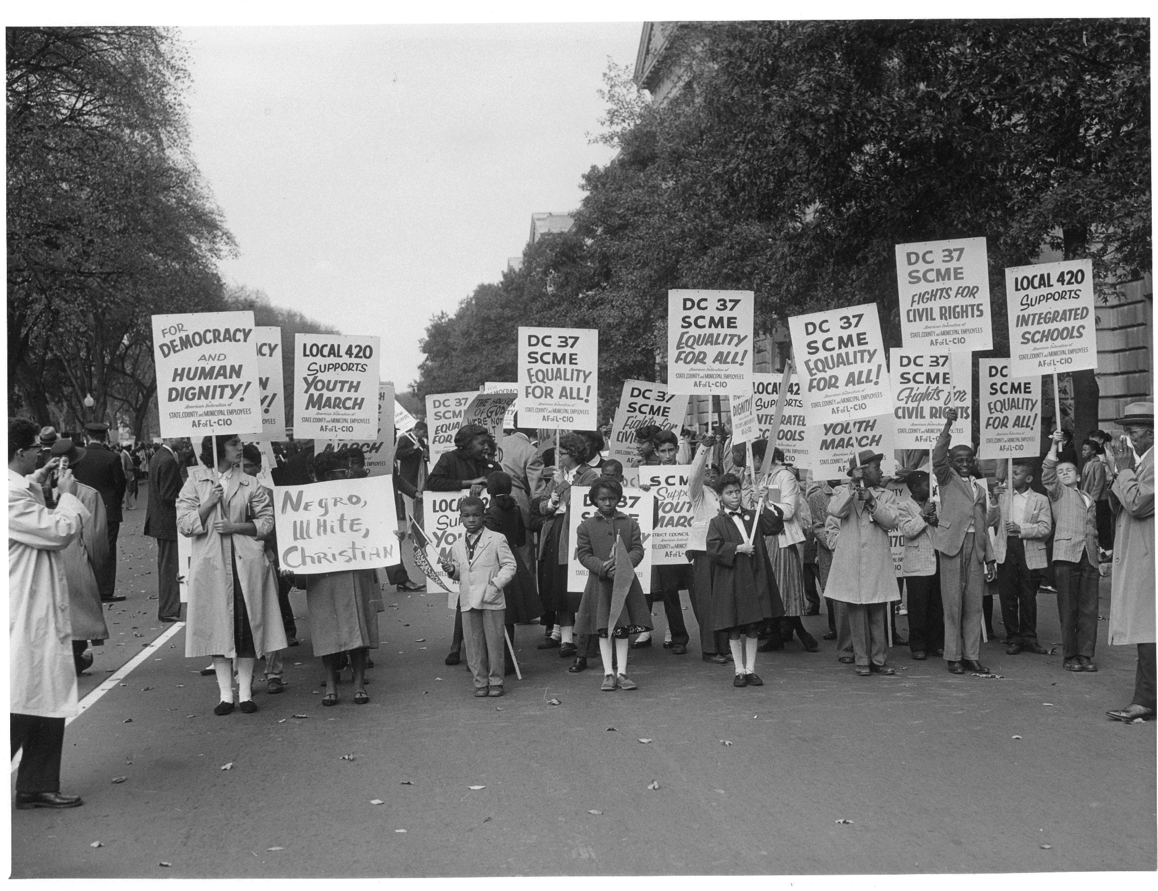
Civil Rights Legislation (1963-1968)
Watch this PBS video clip on the achievements of the civil rights movement to get started.
Notes:
Image
Description: Photograph of Lincoln Memorial Youth March for Integrated Schools, October 25, 1958.
Source: National Archives

Slide 2
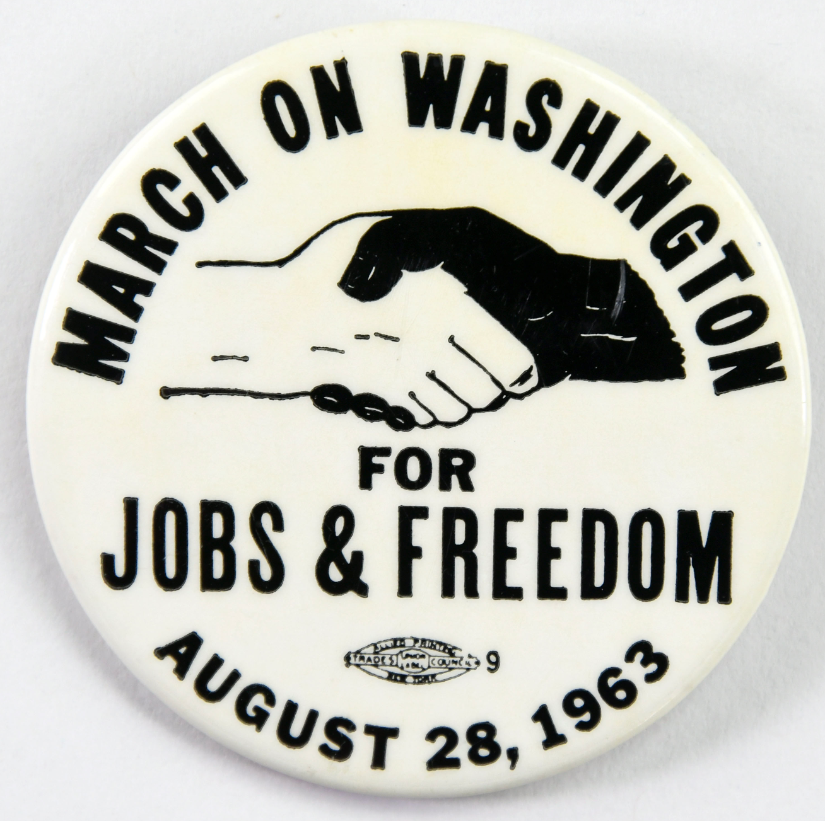
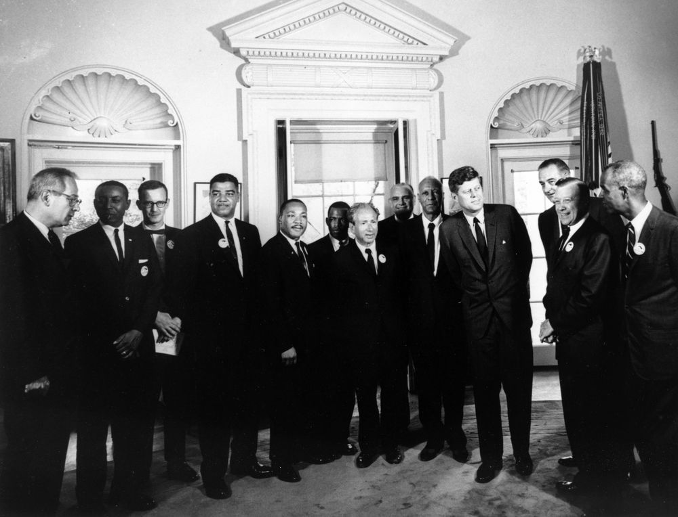
March on Washington for Jobs and Freedom
August 28, 1963
Dr. King was one of the lead organizers for the historic March on Washington. An estimated 250,000 people gathered for the protest and to hear King deliver his “I Have a Dream” speech. National attention of this march forced lawmakers to see the need for the Civil Rights Act of 1964.
Notes:
Left Image:
Description: A commemorative button worn by attendees of the March on Washington for Jobs and Freedom, August 28, 1963.
Source: National Archives
Right Image
Description: President John F. Kennedy and Vice President Lyndon B. Johnson meet with organizers of "The March on Washington for Jobs and Freedom” in the Oval Office, White House, Washington, D.C.
Source: John F. Kennedy Presidential Library and Museum

Slide 3
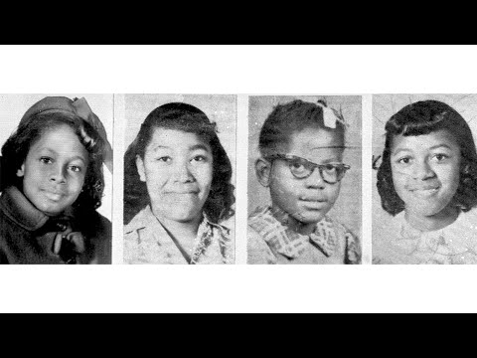
Sixteenth Street Baptist Church Bombing
On Sunday, September 15, 1963, a bomb ripped into Sixteenth Street Baptist Church, killing four Black girls in Birmingham, Alabama. Members of the Ku Klux Klan were arrested. Dr. King had preached at this church during the Birmingham Campaign, and it was at the heart of the Black community. The bombing occurred just two weeks after the March on Washington.
Images from the bombing were broadcast around the world, putting pressure on American lawmakers to bring about civil rights legislation.
Notes:
Video Source: Voices of the Civil Rights Movement

Slide 4
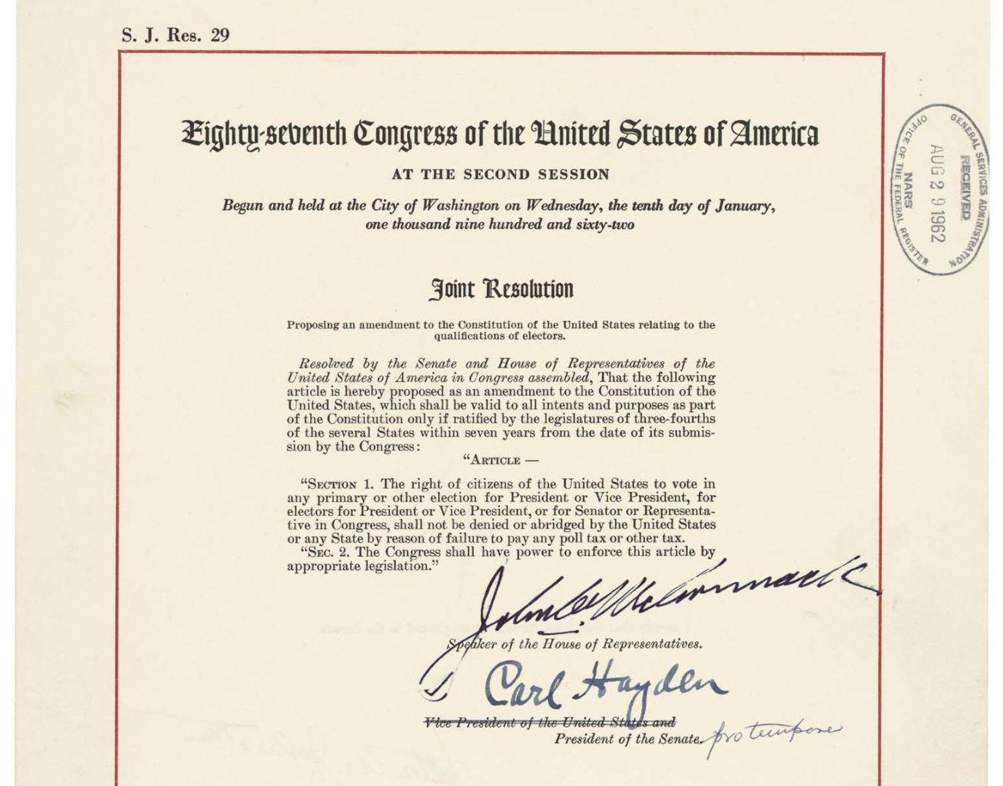
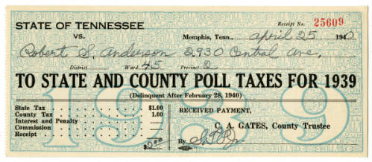
End the Poll Tax via 24th Amendment
What is a poll tax? Many Southern states charged a fee to Black citizens who wanted to vote. With unequal pay and unfair hiring practices, most Black citizens did not have money to spare and therefore were kept out of the democratic process. The protests and voter registration drives in the South, led by Dr. King and others, helped to usher in this Amendment.
Section 1. The right of citizens of the United States to vote in any primary or other election for President or Vice President, for electors for President or Vice President, or for Senator or Representative in Congress, shall not be denied or abridged by the United States or any State by reason of failure to pay any poll tax or other tax.
Notes:
Left Primary Source
Description: The state of Tennessee charged Mr. Robert S. Anderson $2.00 in order for him to vote in the 1940 election.
Source: Tennessee Virtual Archive
Right Primary Source
Description: Signed copy of the 24th Amendment, which was ratified by 38 states and amended to the U.S. Constitution on January 24, 1964.
Source: National Archives

Slide 5
What was the Civil Rights Act of 1964?
Visit the Civil Rights Act of 1964: A Long Struggle for Freedom video exhibit from the Library of Congress to learn more about this historic piece of legislation.
Notes:
Source: Library of Congress

Slide 6
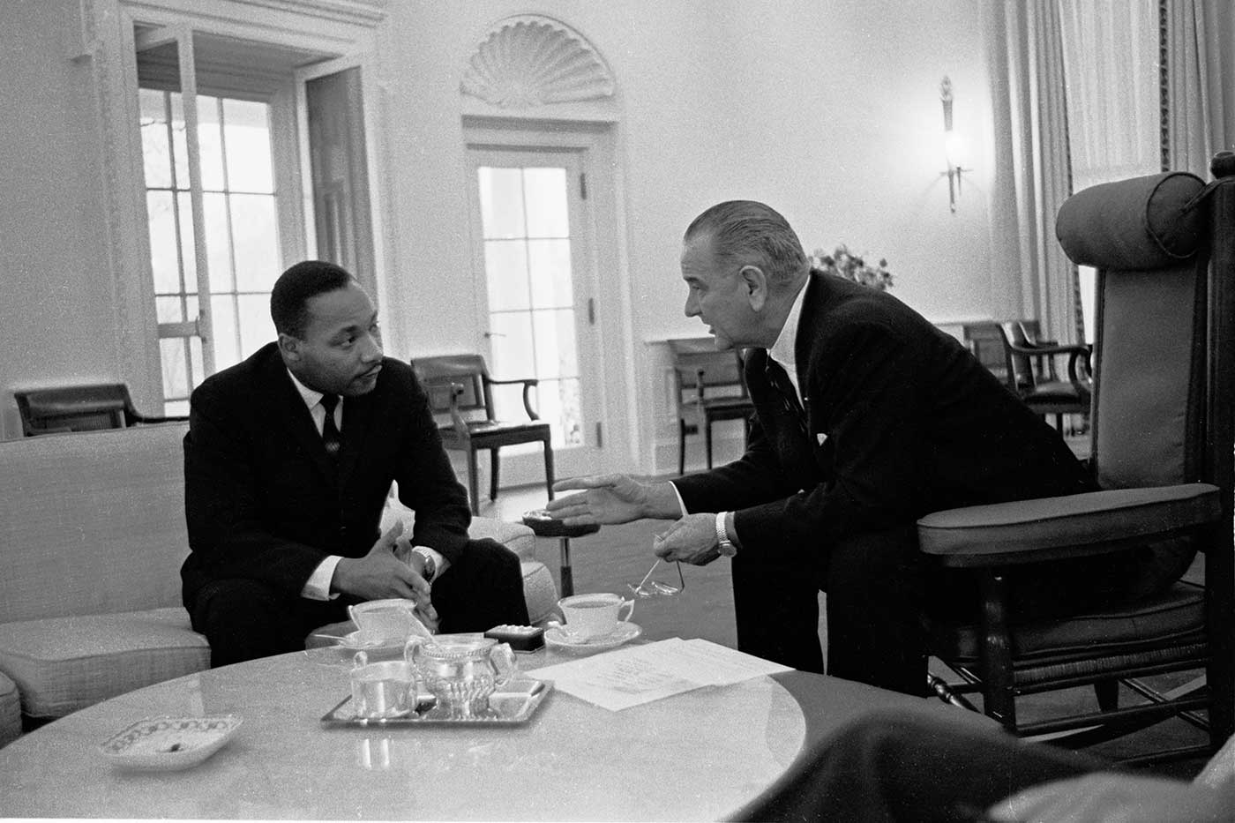
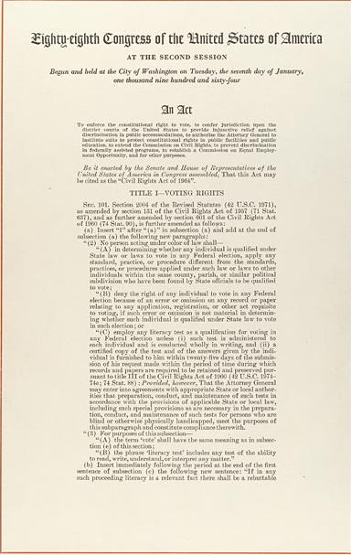
Civil Rights Act of 1964
The Civil Rights Act of 1964 prohibits discrimination on the basis of race, color, religion, sex, or national origin. Provisions of this civil rights act also forbade discrimination on the basis of sex or race in hiring, promoting, and firing.
Listen to President Johnson’s remarks when signing the Civil Rights Act of 1964 on July 2, 1964.
Notes:
Right Image
Description: Official copy of Civil Rights Act of 1964 which was signed by President Johnson on July 2, 1964.
Source: National Archives and Records Administration
Left Image
Description: Dr. King and President Johnson talked on a regular basis about the struggle for civil rights. This photo captures their January 1, 1964 meeting in the Oval Office of the White House.
Source: Lyndon B. Johnson Presidential Library

Slide 7
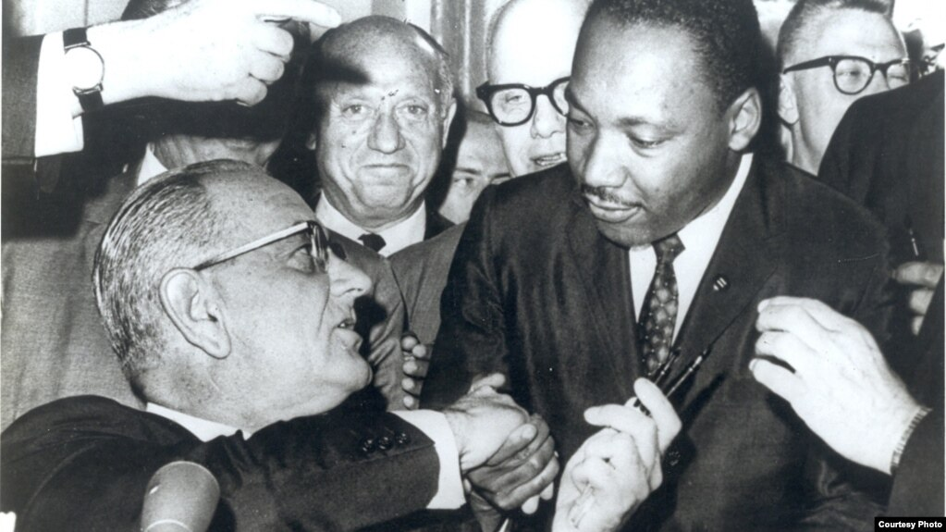
Voting Rights Act of 1965
This act was signed into law on August 6, 1965, by President Lyndon Johnson. It outlawed the discriminatory voting practices adopted in many southern states after the Civil War, including literacy tests as a prerequisite to voting.
Notes:
Image Source: President Lyndon B. Johnson Presidential Library
Video Source: Center for Civic Education

Slide 8
Dr. Martin Luther King, Jr. was
assassinated April 4, 1968.
On the previous night, Dr. King delivered his, “I’ve Been to the Mountaintop” speech, where he told the audience:
“I've seen the Promised Land. I may not get there with you. But I want you to know tonight, that we, as a people, will get to the promised land!”
At 6:05 p.m. on Thursday, April 4, 1968, Dr. Martin Luther King was shot dead while standing on a balcony outside his second-floor room at the Lorraine Motel in Memphis, Tennessee. News of King’s assassination prompted major outbreaks of racial violence, resulting in more than 40 deaths nationwide and extensive property damage in over 100 American cities. King was in Memphis to support the majority Black sanitation workers who were on strike demanding better working conditions.

