Slide 1
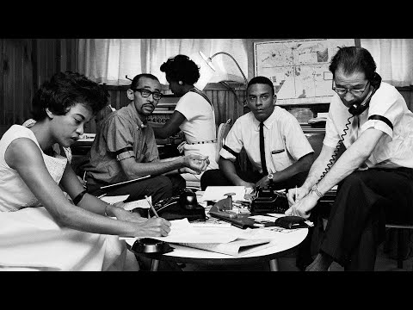
Birmingham Campaign
April 3, 1962 to
May 11, 1963
Notes:
Video Source: Voices for Civil Rights

Slide 2
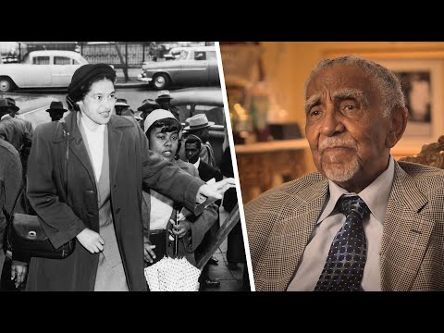
Summary
The Birmingham campaign was part of the civil rights movement to bring an end to racial inequality. The Birmingham campaign was organized in early 1963 by the Southern Christian Leadership Conference (SCLC) and led by Dr. Martin Luther King Jr. to bring attention to the integration efforts of African Americans in Birmingham, Alabama.
The protests gained national attention and eventually ended segregation at city restrooms, drinking fountains, and lunch counters.
Learn how the SCLC first started.

Slide 3
What was the Birmingham Campaign?
Visit the Library of Congress to view the CBS Eyewitness: Breakthrough in Birmingham special broadcast.
Notes:
Video
Source: Library of Congress | CBS Special Report broadcast May 10, 1963
Description: In May 1963, police in Birmingham, Alabama, responded to marching African American youth with fire hoses and police dogs to disperse the protesters, as the Birmingham jails already were filled to capacity with other civil rights protesters. Televised footage of the attacks shocked the nation, just as newspaper coverage shocked the world. This excerpt from CBS Eyewitness: Breakthrough in Birmingham, broadcast on May 10, 1963, includes televised footage seen by millions, as well as a brief interview with Martin Luther King, Jr., (1929–1968), one of the leaders of the movement in Birmingham, who discusses the importance of achieving success there.
Motion Picture, Broadcasting and Recorded Sound Division. Courtesy of CBS News

Slide 4
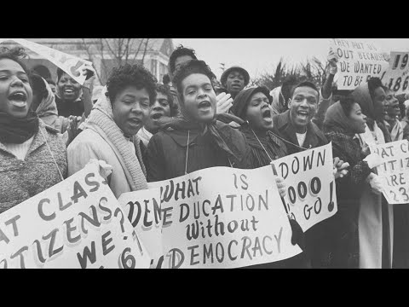
Nonviolent Peaceful Protest Methods
Listen to learn about Dr. King’s belief in a nonviolent approach to bring about change.
Protesters who participated in marches, sit-ins, and demonstrations were instructed by King to remain peaceful, no matter how they were treated by police or the community.
Notes:
Video Source: Voices of the Civil Rights Movement
Audio clip source: Center for Civic Education

Slide 5
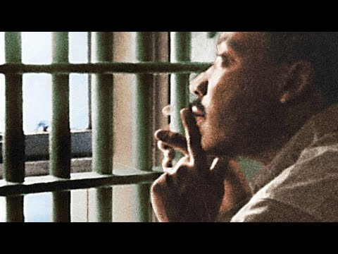
Learn more about the Good Friday March and Dr. King’s arrest.
Notes:
Article Source: Equal Justice Initiative
Video Source: Smithsonian Channel

Slide 6
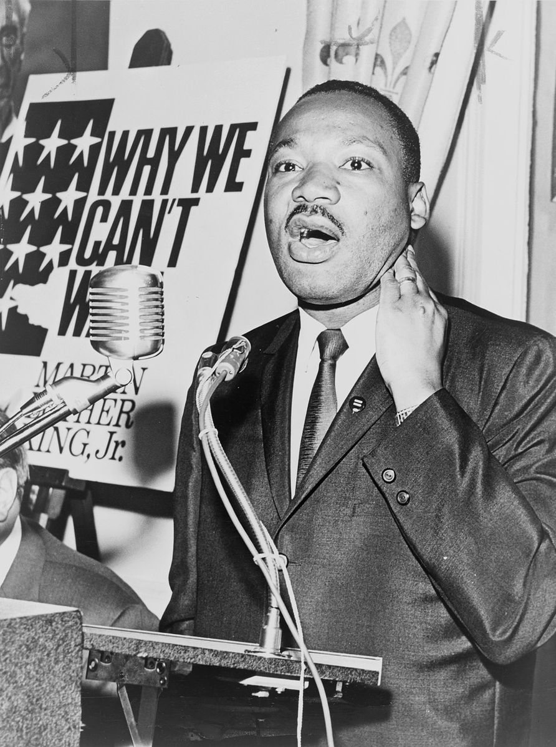
Letter from a Birmingham Jail
After he was arrested, King was criticized by other Black religious leaders for being an agitator and extremist. He responded with a “Letter from a Birmingham Jail.” This letter is considered one of the most important documents in the history of the Civil Rights Movement.
In the letter, King argues that Black Americans have waited long enough to receive equal treatment. His letter is a call for unity in a nonviolent protest against the oppression of segregation and discrimination.
“Injustice anywhere is a threat to justice everywhere.”
Discover even more about this famous letter!
Notes:
Image source: Library of Congress

Slide 7
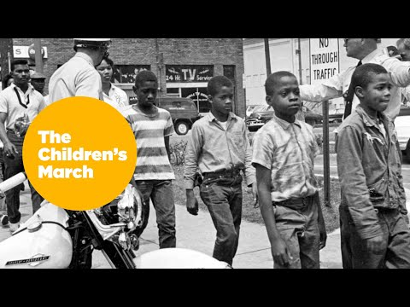
National Media Coverage
While Dr. King was originally hesitant for young people to march, by May 2, 1963, he supported the Children’s Crusade. Examine more about how the media covered the Birmingham Campaign.
Notes:
Article Source: National Public Radio
Video Source: Atlanta History Center

Slide 8
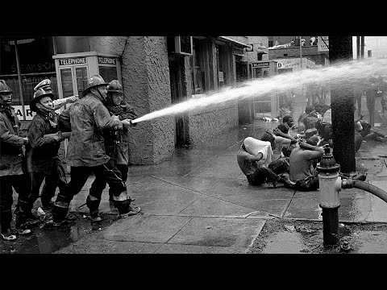
On May 10, 1963, Dr. King and other leaders announced an agreement from the city of Birmingham to desegregate lunch counters, restrooms, drinking fountains, and dressing rooms within 90 days. The city also agreed make hiring practices fair for Black citizens.
Notes:
Video Source: Voices for Civil Rights

