Slide 1
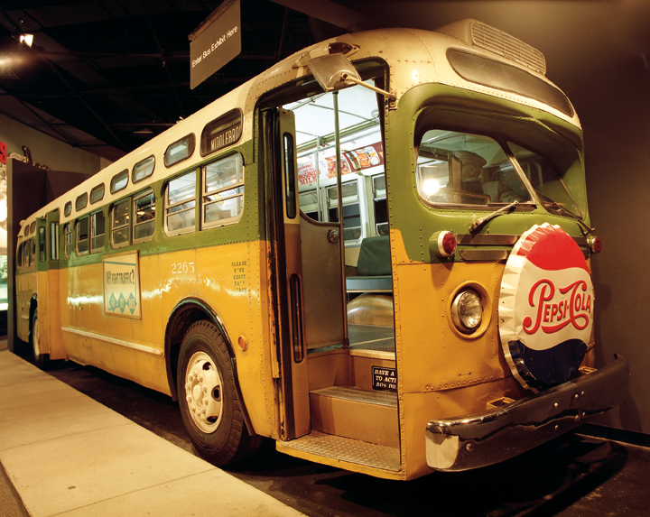
Montgomery Bus Boycott
December 5, 1955 – December 20, 1956
Notes:
Image:
Description: On the evening of December 1, 1955, Rosa Parks, an African American woman, was arrested for disobeying an Alabama law requiring Black passengers to relinquish seats to White passengers when the bus was full. Blacks also were required to sit at the back of the bus. Her arrest sparked a 381-day boycott of the Montgomery bus system and led to a 1956 Supreme Court decision banning segregation on public transportation. This photograph features a replica of the bright yellow Montgomery city bus where Rosa Parks defied the city's segregated bus transport policy, which is on exhibit at the National Civil Rights Museum in Memphis, Tennessee.
Source: National Archives

Slide 2
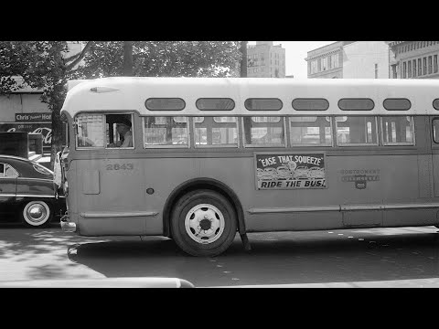
What was the Montgomery Bus Boycott?
Notes:
Video Source: Voices of the Civil Rights Movement

Slide 3
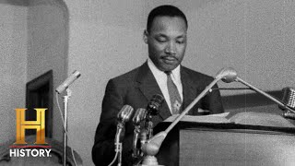
Play this clip for background on the Montgomery Bus Boycott. Listen for Dr. King’s message to the citizens of Montgomery.
The Montgomery Improvement Association (MIA) was formed in Montgomery, Alabama, on December 5, 1955, to direct the Black boycott of the city’s segregated buses. Martin Luther King, Jr., was elected its president, and Rosa Parks served on the executive board of directors.

Slide 4
Examine this article about the bombing of Dr. King’s Montgomery home on
January 30, 1956.
A little over one month into the Montgomery Bus Boycott, the home of King family was bombed. His wife, Mrs. Coretta Scott King, his seven-week old daughter, and a neighbor were inside at the time but no one was injured. Dr. King was addressing an MIA meeting at the time of the bombing. After learning his family was safe, Dr. King continued his speech, telling the crowd, “We cannot solve this problem through violence. We must meet violence with nonviolence."

Slide 5
The Montgomery Bus Boycott was a civil rights protest during which Black Americans refused to ride city buses in Montgomery, Alabama, to protest segregated seating. The boycott took place from December 5, 1955, to December 20, 1956. This protest is regarded as the first large-scale demonstration against racial segregation in America. It is estimated over 40,000 people participated in the year long boycott.
Explore this site to learn about the leadership and the lasting impact of the bus boycott.

Slide 6
Examine this article about the economic impact of the bus boycott on the city of Montgomery.
Excerpt from New York Times article, January 7, 1956
Negroes’ Boycott Cripples Bus Line
Carrier in Montgomery Alabama., Increases Fares to Offset Loss of Business
The boycott of Montgomery bus lines by Negro riders entered its second month this week with no conciliation in sight. As a result of the company’s loss of revenue in the boycott, the City Commission Wednesday raised fares 50 per cent: adult fares from 10 to 15 cents, school fares from 5 to 8 cents. The commission also authorized a 5 cent charge for transfers, which have heretofore been free.
Asking for the increase, the bus company cited losses averaging 22 cents a mile since the boycott began Dec. 5th. The losses would run even higher, company spokesmen said, except for a curtailment in service that has reduced mileage by 31 per cent. Shortly after the boycott began, virtually all service to the Negro communities was abolished. Two routes, serving predominantly Negro areas, were abandoned entirely and other routes revised so as to exclude Negro neighborhoods among them.
Notes:
Primary Source: New York Times Special Edition | Learning for Justice

Slide 7
The boycott had lasted over a year when the Black citizens of Montgomery learned the Supreme Court had finally ruled in their favor. Dr. King offered 17 suggestions to Montgomery citizens encouraging them to maintain a nonviolent approach to bus integration.
Visit the Alabama State Archives to examine Dr. King’s response.
Notes:
Primary Source: Inez Jesse Turner Baskin papers | Alabama Department of History & Archives

Slide 8
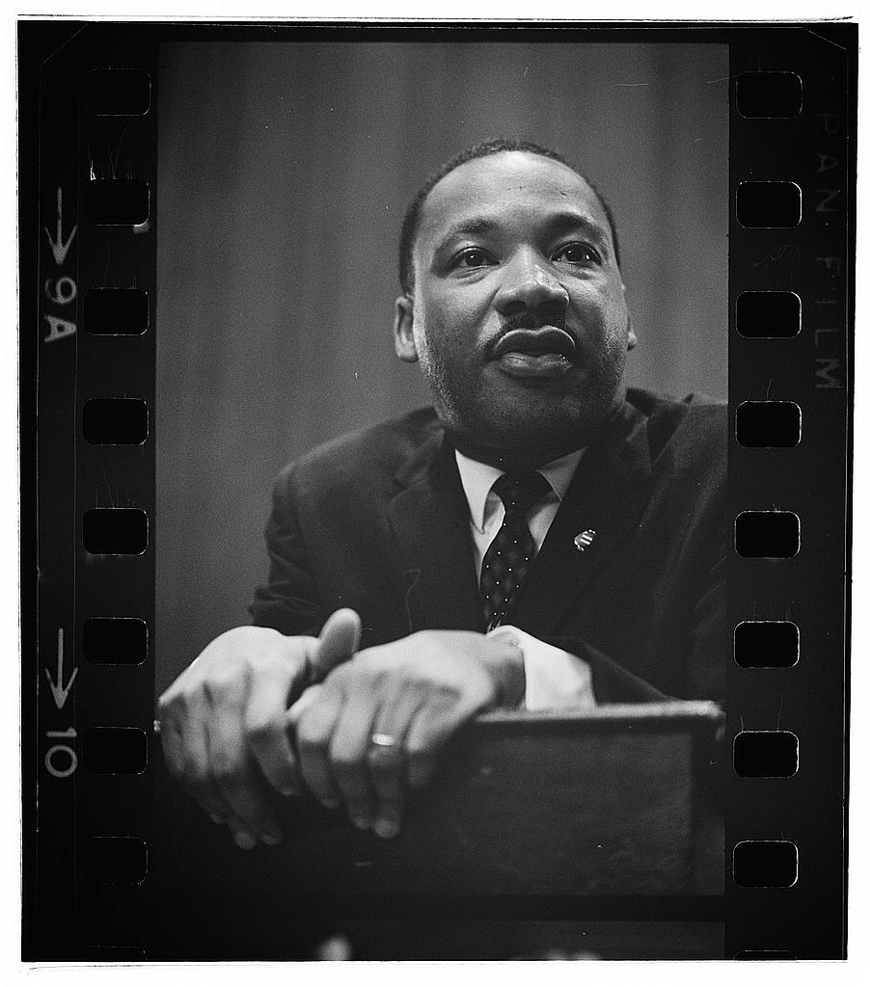
The Montgomery Bus Boycott did much more than desegregate the bus system in Montgomery. The protest brought the civil rights movement to national attention and Martin Luther King Jr. into the public eye as a leader of the movement.
Notes:
Image Source: Library of Congress

