Slide 1
Escape
Misinformation
Should I believe everything I see and hear online?
Notes:
Slide template: Slides Carnival

Slide 2
Source Who produced it & are they trustworthy?
Audience Who is supposed to see, hear or read it?
Execution How & when was it presented?
Evidence Can you confirm the facts are true?
Context Can you verify it with another trusted source?
Purpose Why was it created?

Slide 3
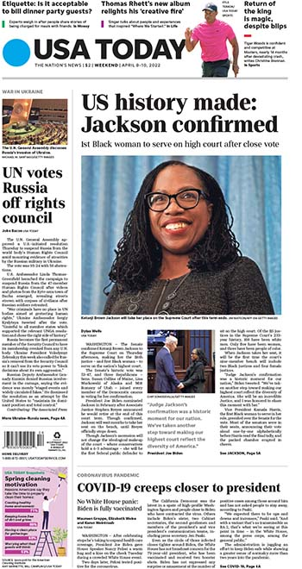
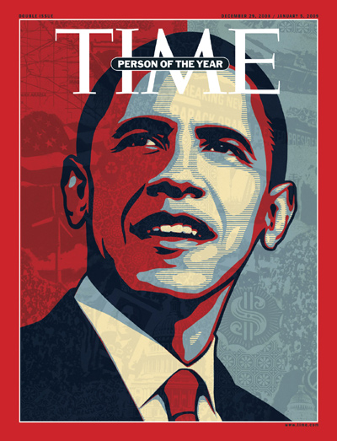
SOURCE
Who produced it & are they trustworthy?
Notes:
Vocabulary Support
Source: Communication tools or channels used to share and store information, news and data

Slide 4
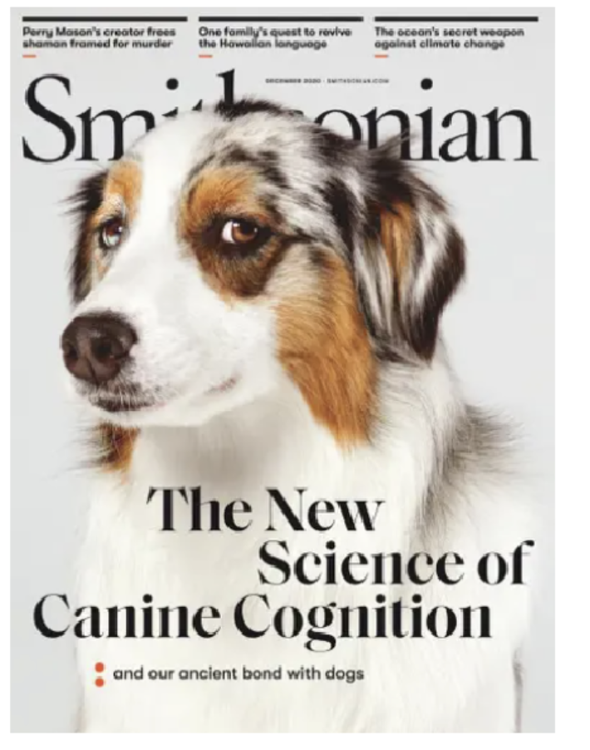
AUDIENCE
Who is supposed to see, hear or read it?
Notes:
Vocabulary Support - Audience is also referred to as the media consumer
Media Consumer: A person who receives and interprets media texts or images

Slide 5
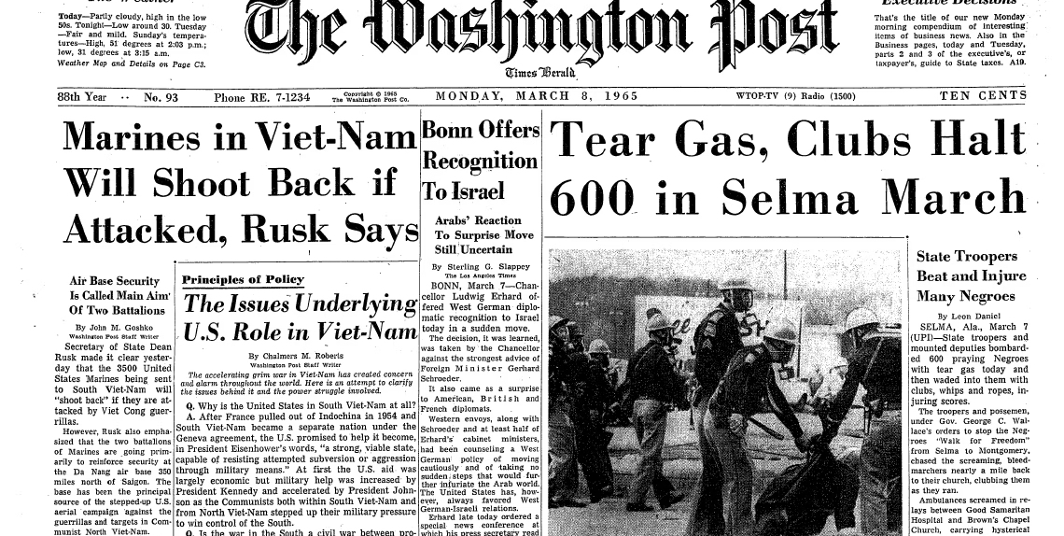
EXECUTION
How & when was it presented?

Slide 6
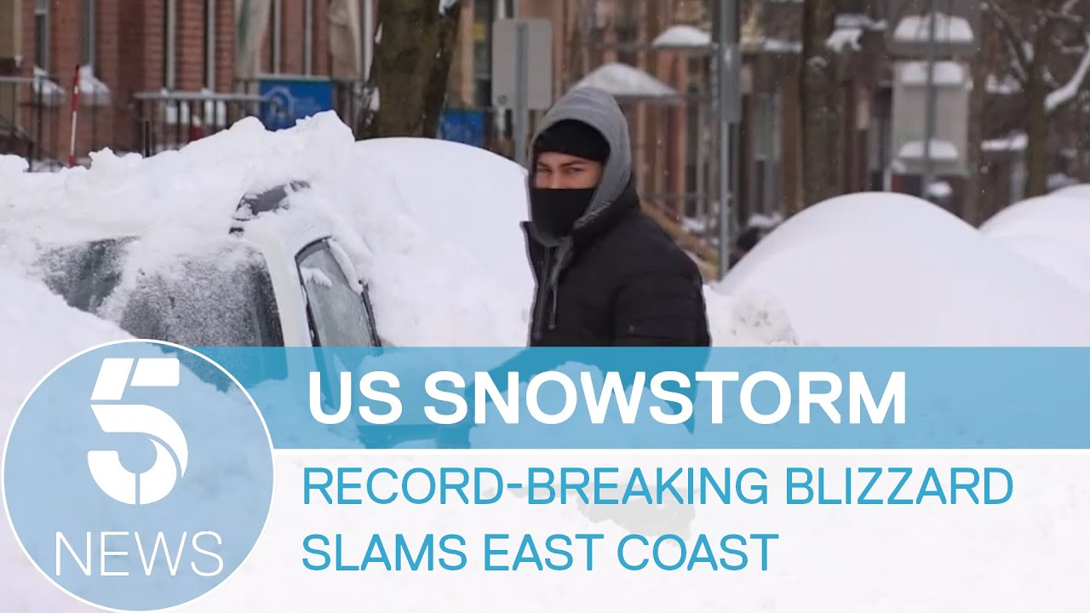
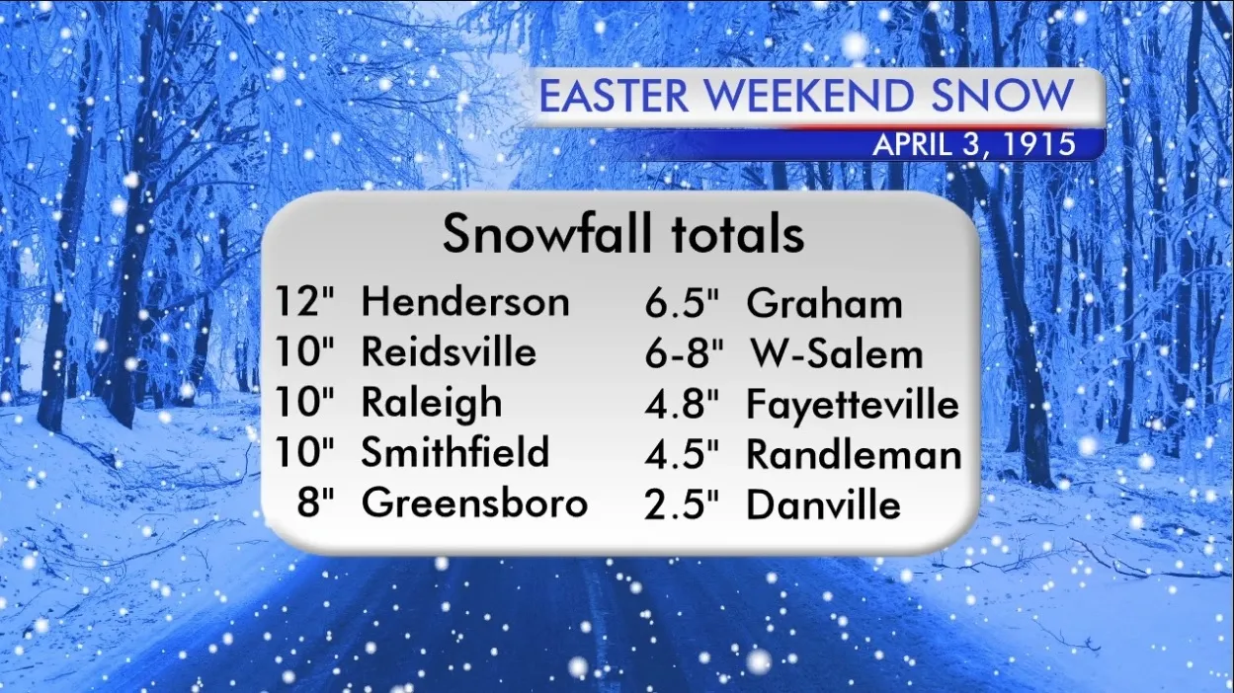
EVIDENCE
Can you confirm the facts are true?
Notes:
Vocabulary Support:
Fact-check: To verify the accuracy of statements or news stories

Slide 7
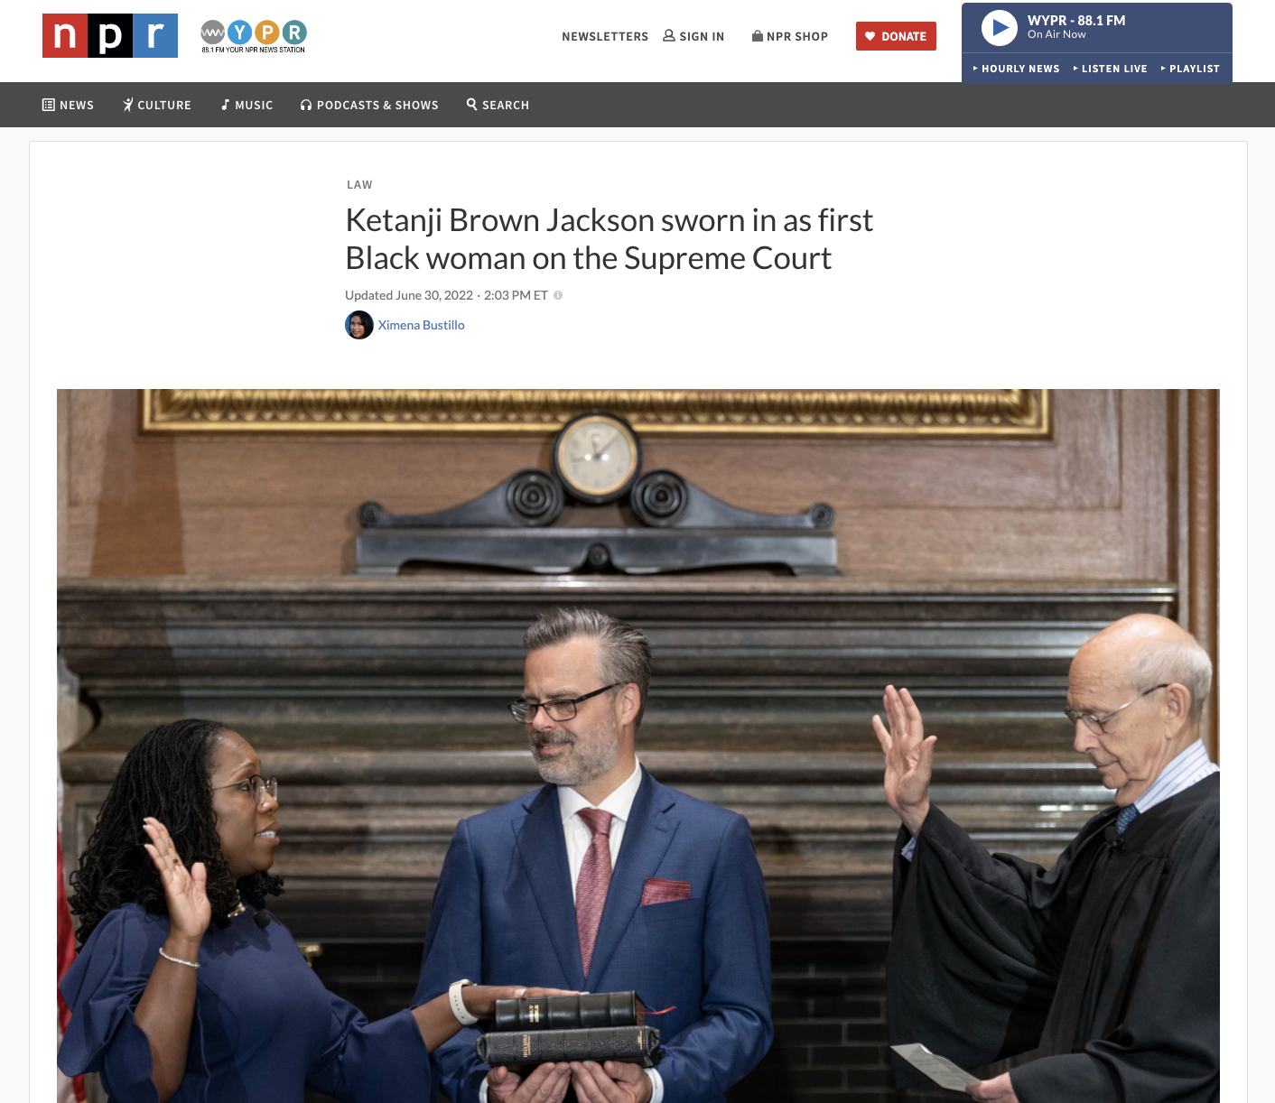
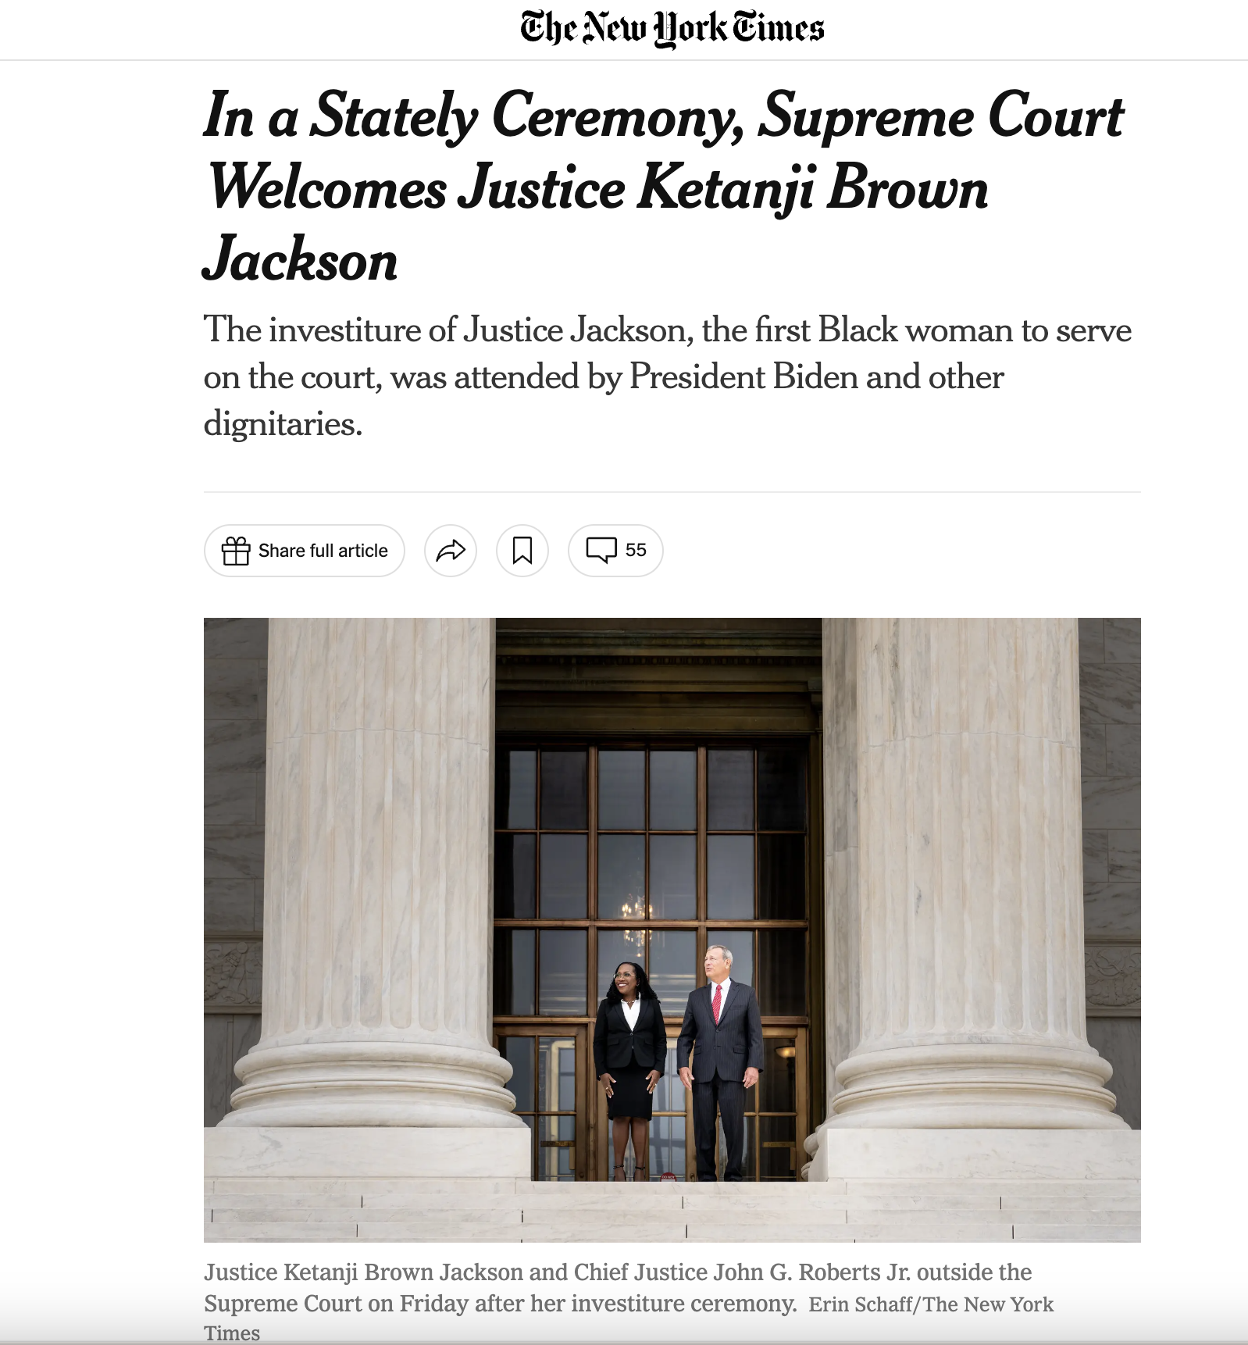
CONTEXT
Can you verify it with another trusted source?
Notes:
Vocabulary Support:
Corroborate: To support with evidence or authority

Slide 8
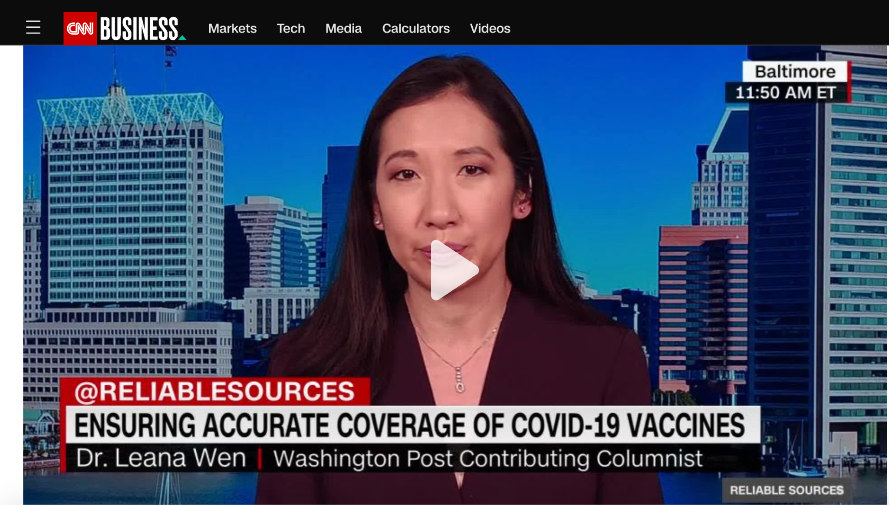
PURPOSE
Why was it created?

Slide 9
Let’s pause for more:
Tips & Tricks
Notes:
Vocabulary Support:
Fake News: Inaccurate or false information spread online by either news services or via social media

Slide 10
E | Evidence Can you confirm the facts are true?
S | Source Who produced it & are they trustworthy?
C | Context Can you verify it with another trusted source?
A | Audience Who is supposed to see, hear or read it?
P | Purpose Why was it created?
E | Execution How & when was it presented?

Slide 11
Let’s practice
Apply the ESCAPE strategy as you investigate your assigned article to determine if it is trustworthy. Capture notes from your investigation in your Practice Your Escape organizer.
Advancing Climate Solutions
Handiwork of Good Health
Help Save the Pacific Northwest Tree Octopus

Slide 12
Escape Room
Can you use your media literacy skills to escape misinformation?

Slide 13
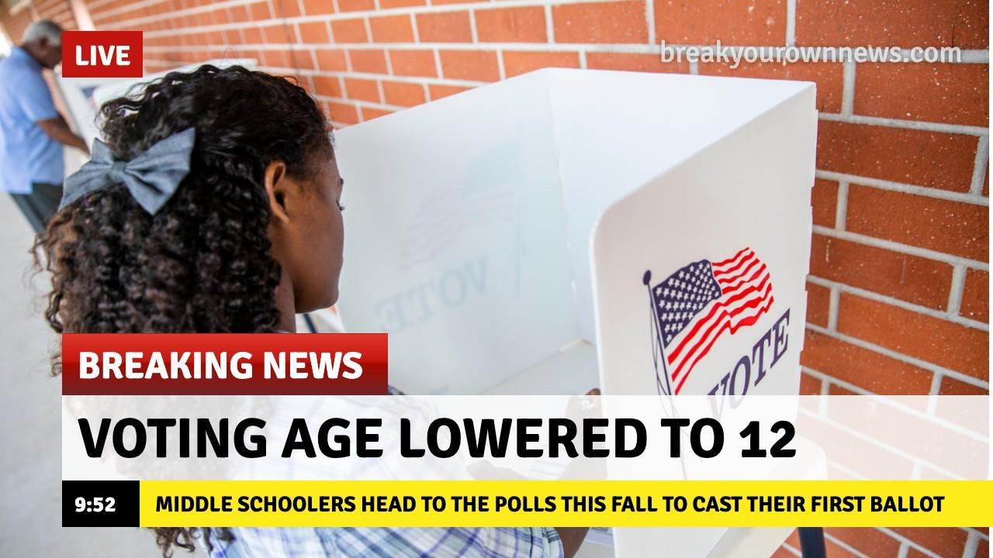
Room 1
TRUSTWORTHY
or
MISINFORMATION?

Slide 14
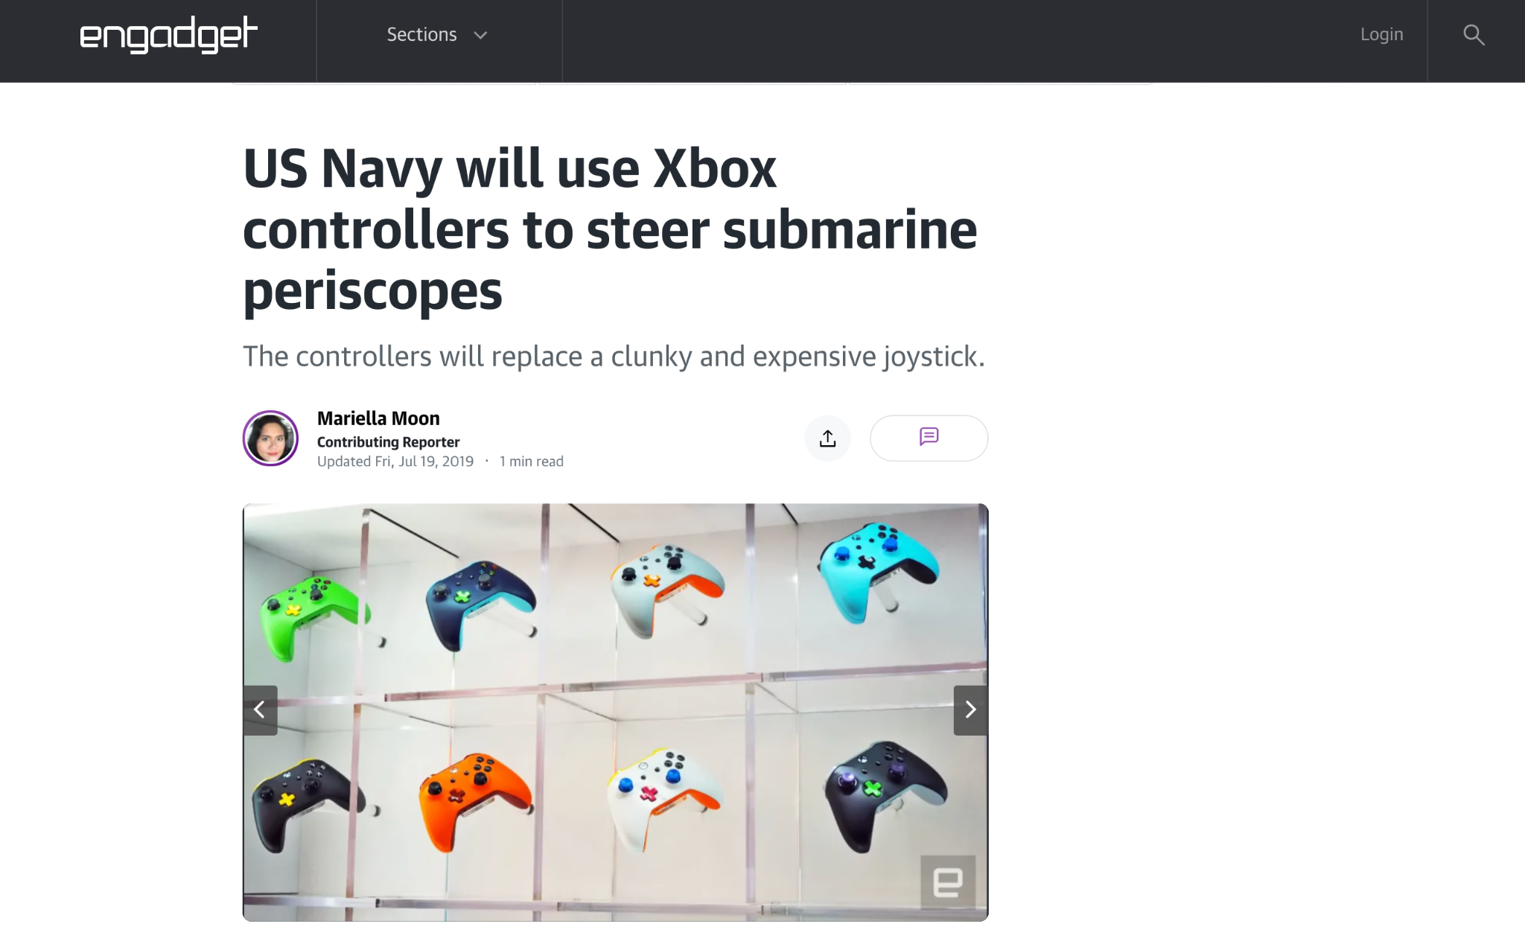
Room 2
TRUSTWORTHY
or
MISINFORMATION?
Notes:
Edgadget.com

Slide 15
Room 3
TRUSTWORTHY
or
MISINFORMATION?
Notes:
Center Civic Education

Slide 16
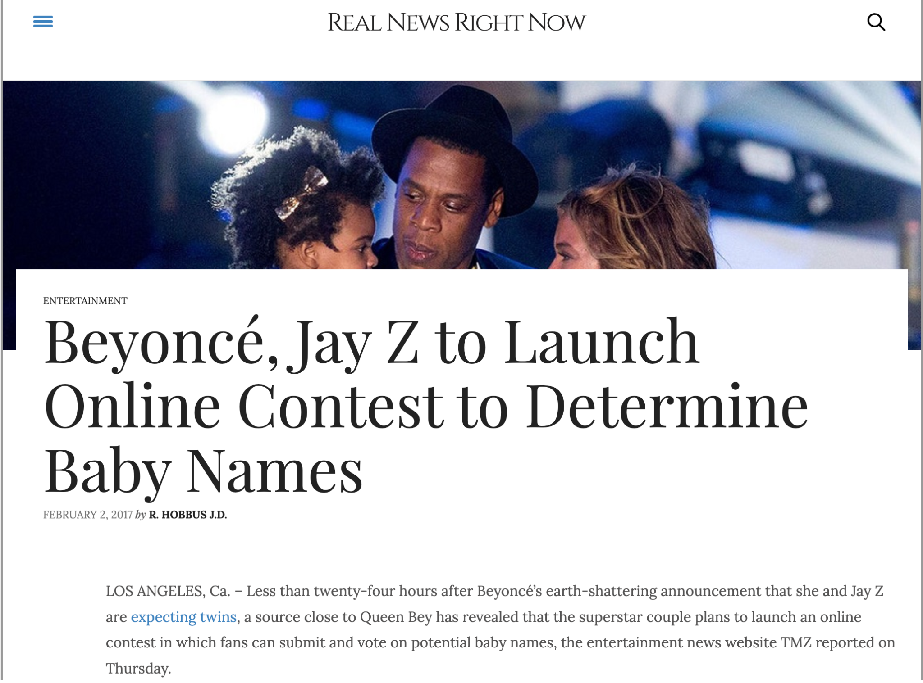
Room 4
TRUSTWORTHY
or
MISINFORMATION?

Slide 17
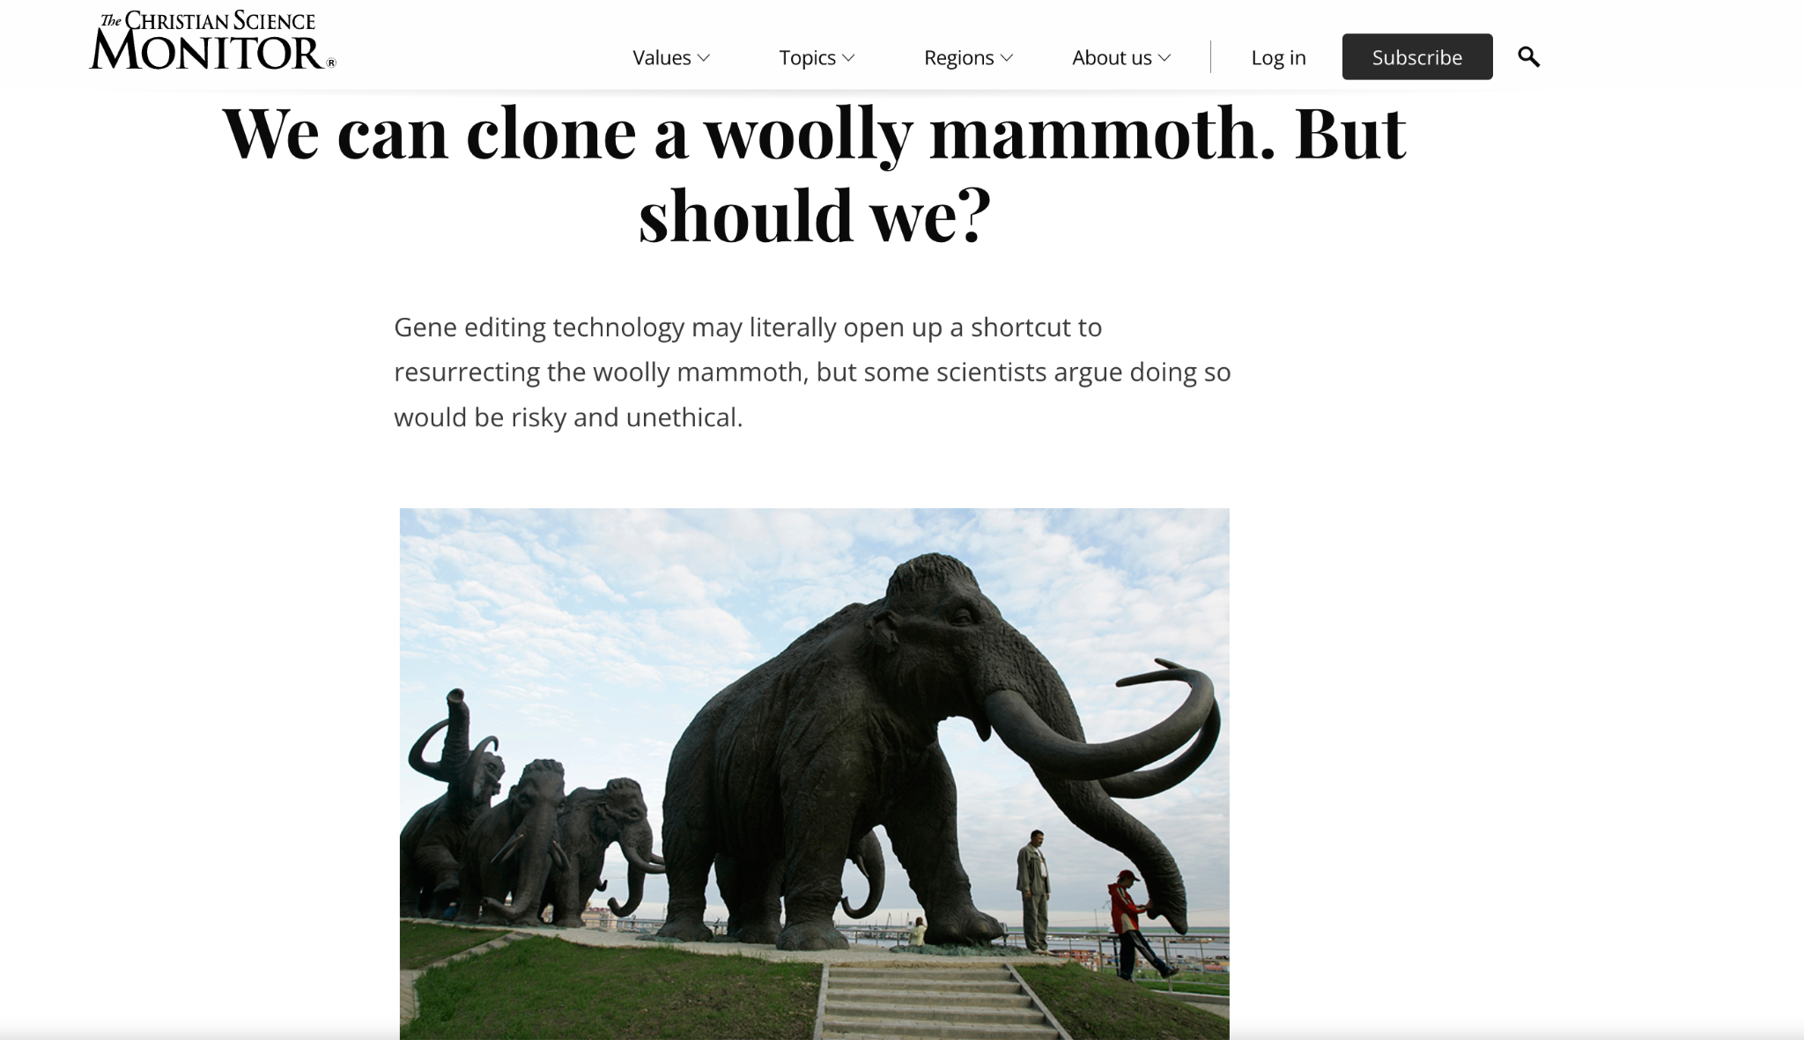
Room 5
TRUSTWORTHY
or
MISINFORMATION?
Notes:
CSMonitor.com

Slide 18
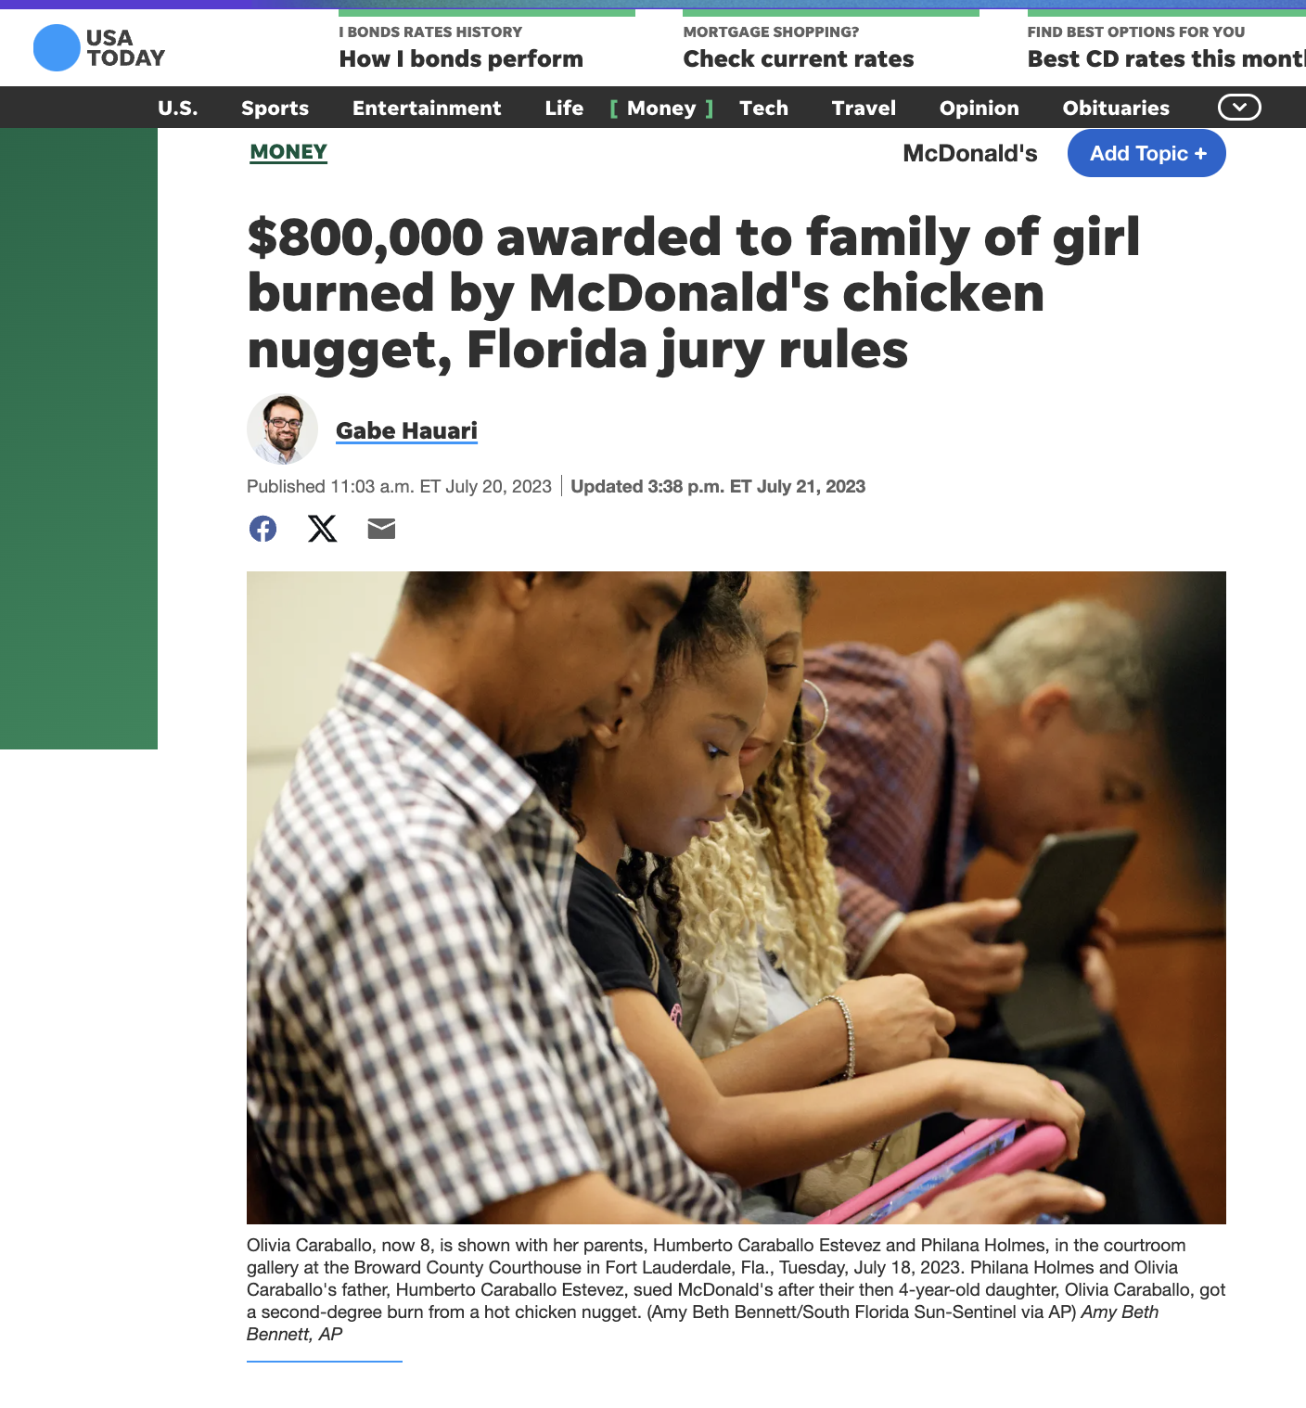
Room 6
TRUSTWORTHY
or
MISINFORMATION?
Notes:
USA Today

Slide 19
Congratulations
You have escaped misinformation!
You are a
media literacy scholar!

Slide 20
Should I believe everything I see and hear online?

